Slide 1
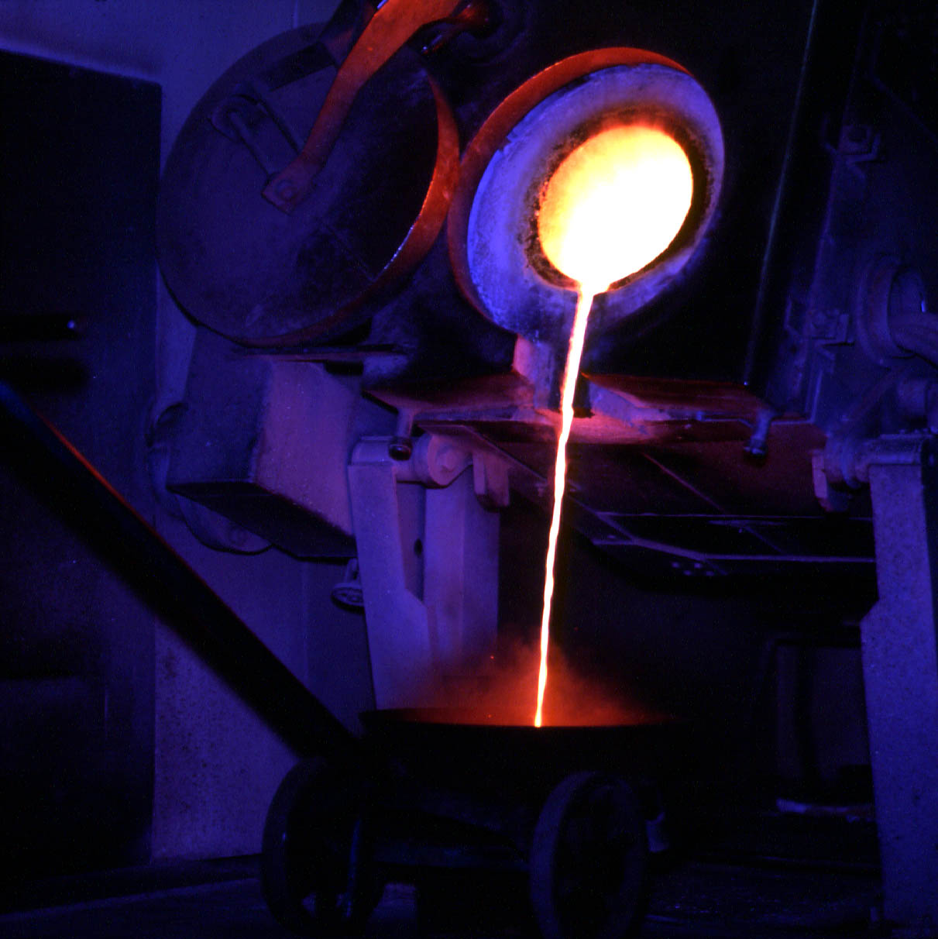
Extraction,
Refining &
Electroplating
of Metals.

Slide 2
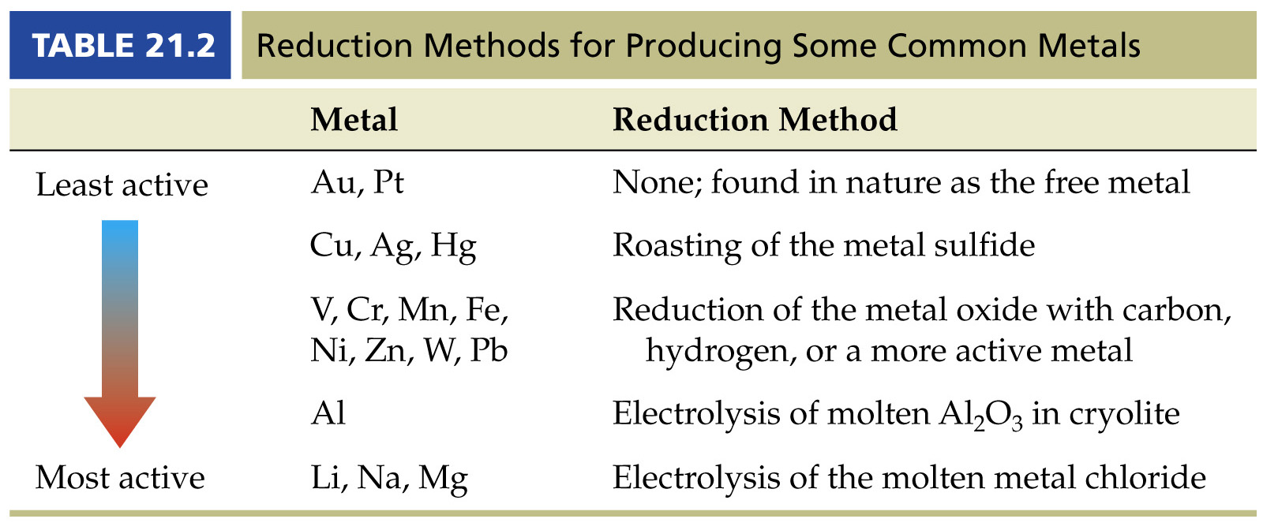
The reduction method chosen for the extraction of a metal from its ore depends on the reactivity of the metal. Some metals react quickly with water so solutions cannot be used. Some metals even react quickly with air so must not be exposed to the atmosphere.

Slide 3
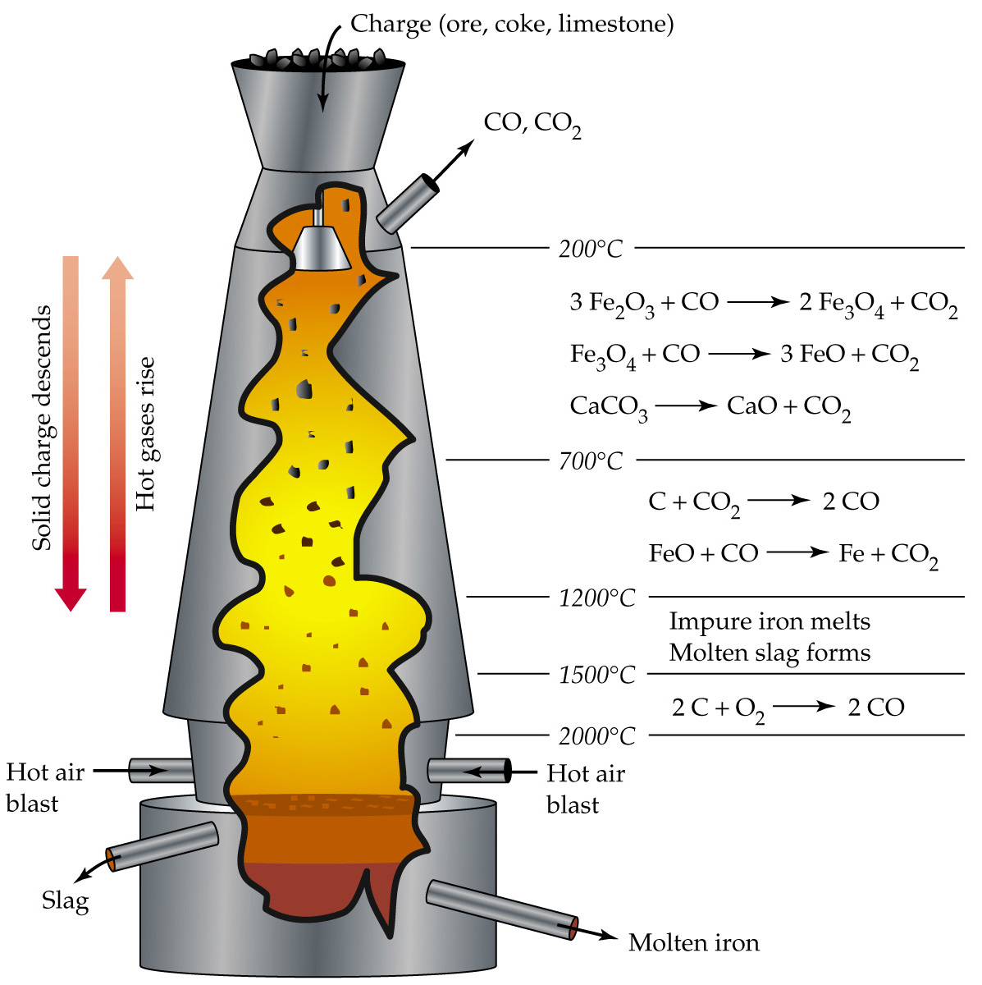
Reduction of Iron Oxide to Iron

Slide 4
Reduction of Iron Oxide to Iron
Overall Reaction

Slide 5
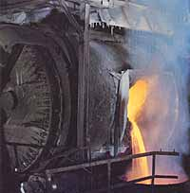
Roasting of Copper Sulfide to Copper
Formation of blister copper by reduction of copper sulphide:
The blister copper produced by this process is 99% pure copper.
CuS_{(s)} + O_{2(g)} → Cu_{(s)} + SO_{2(g)}

Slide 6
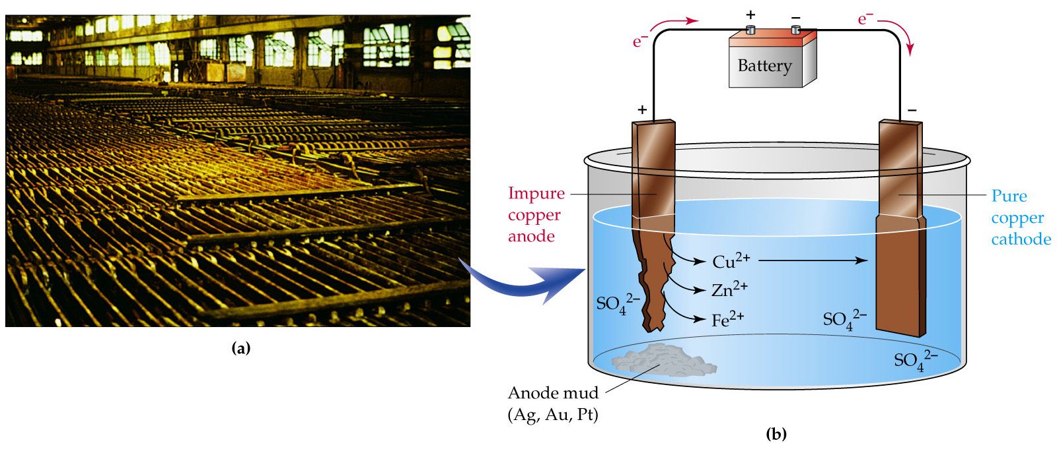
The 99% pure blister copper is purified by electrolysis
Oxidation (anode) Cu_{(s)} + 2 e⁻ → Cu²⁺ _{(aq)}
^{blister}
Reduction (cathode) Cu²⁺_{(aq)} → Cu_{(s)} + 2 e⁻
^{pure}

Slide 7
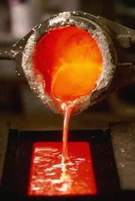
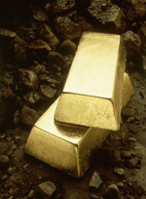
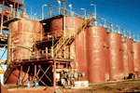
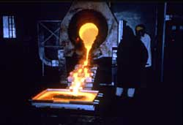
A recovery process in which a slurry of gold ore, free carbon particles and cyanide are mixed together. The pregnant solution is passed counter current through a series of tanks containing activated carbon particles. Gold has a natural affinity for carbon and the carbon absorbs the gold as it passes through the circuit.
Loaded carbon is removed from the slurry by screening. The loaded carbon is stripped in a caustic cyanide solution under heat and pressure prior to the recovery of the gold by electrolysis or by zinc precipitation. The carbon is treated for re-use.

Slide 8
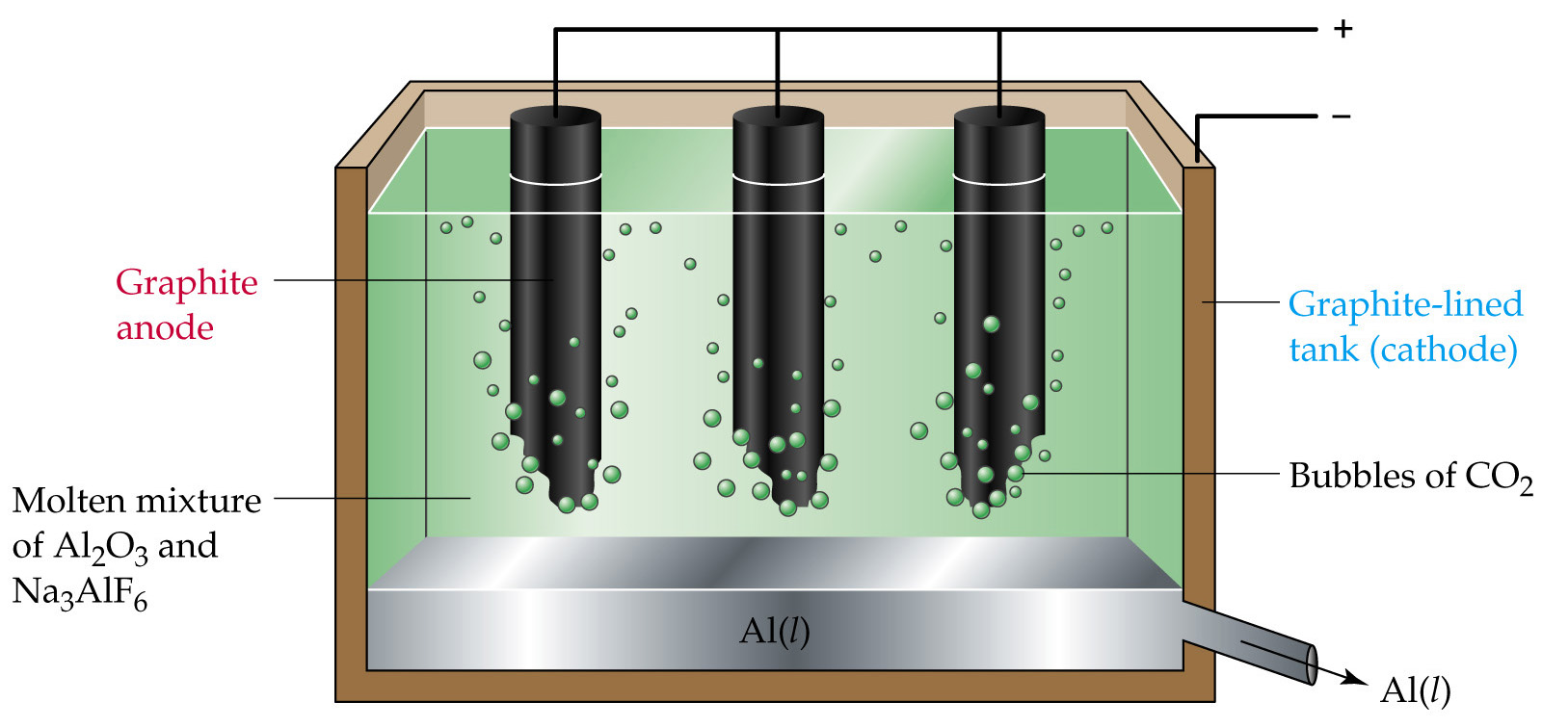
Electrolytic Reduction of Alumina.
Anode : C_{(s)} + 2 O²⁻_{(l)} → CO_{2(g)} + 4 e⁻
Cathode : Al³⁺_{(l)} + 3e⁻ → Al_{(l)}
Overall : 2 Al₂O_{3(l)} + 3 C_{(s)} → 4 Al_{(l)} + 3 CO_{2(g)}
(cryolite)

Slide 9
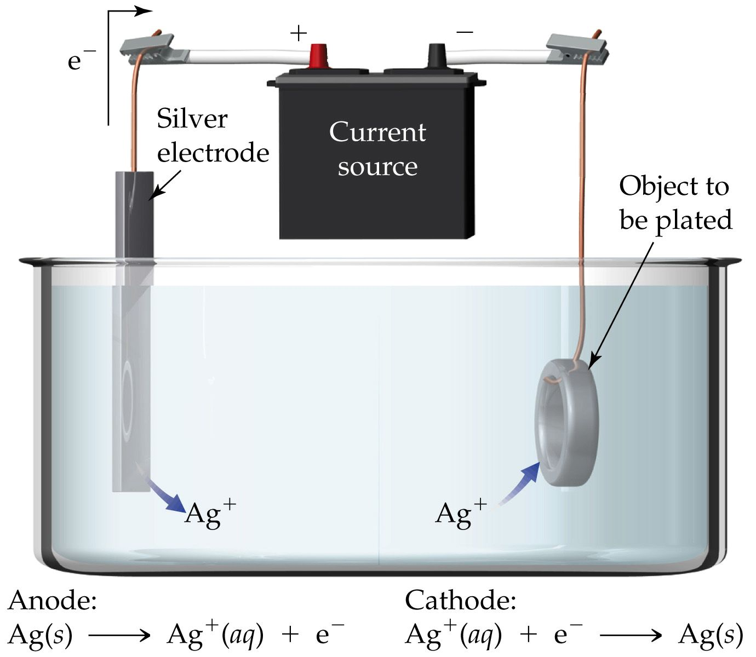

Slide 12
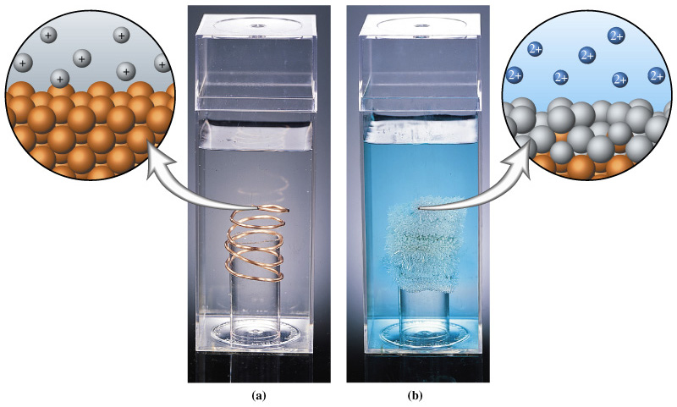
Displacement of Ag+(aq) by Cu(s) in this oxidation-reduction reaction results in the formation of Cu2+ ions as the electrons are transferred to Ag+(aq) to make Ag(s).

Slide 13
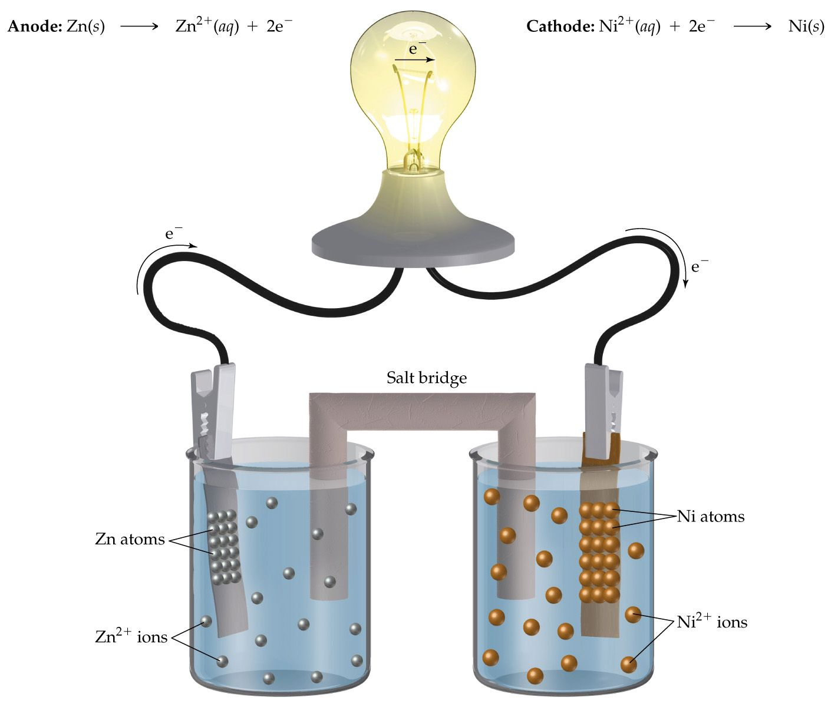
How might this cell appear after it has generated a substantial amount of electrical current?

Slide 14
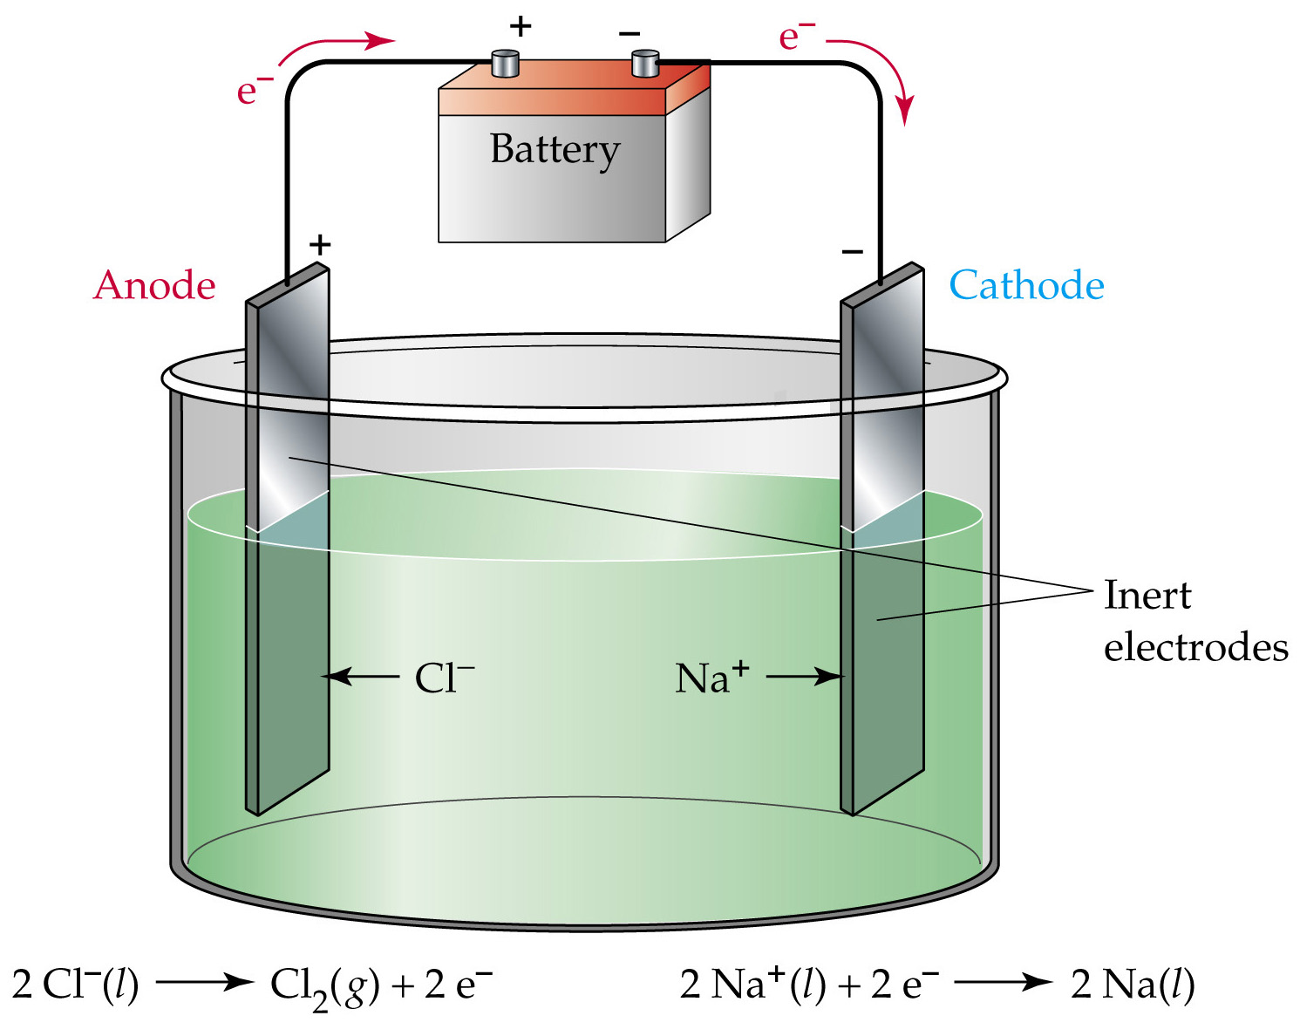

Slide 15
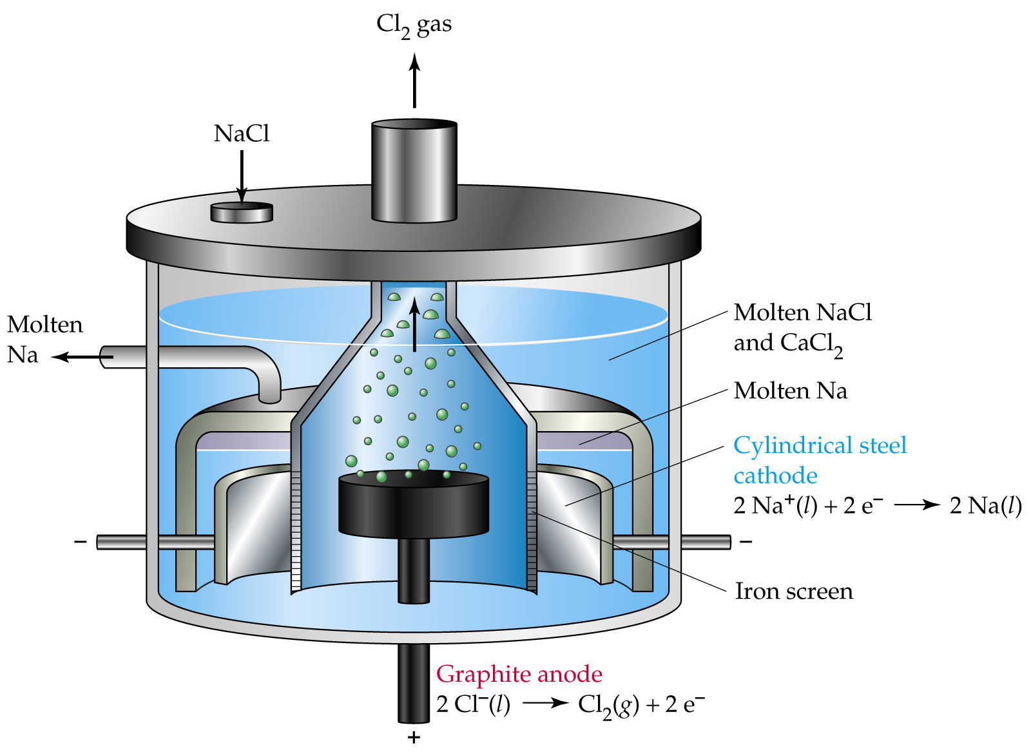
Electrolysis of molten sodium chloride.
Question : Why cant sodium be extracted from NaCl solution?

Slide 16
Electrolysis of molten sodium chloride.
Answer : Sodium is too reactive, the reduction of water has a higher Eº and would therefore occur in preference to Na metal.
Na⁺_{(aq)} + e⁻ → Na_{(s)} Eº = -2.71V
2 H₂O_{(l)} + 2 e⁻ → H_{2(g)} + 2 OH⁻_{(aq)} Eº = -0.41V

Slide 17
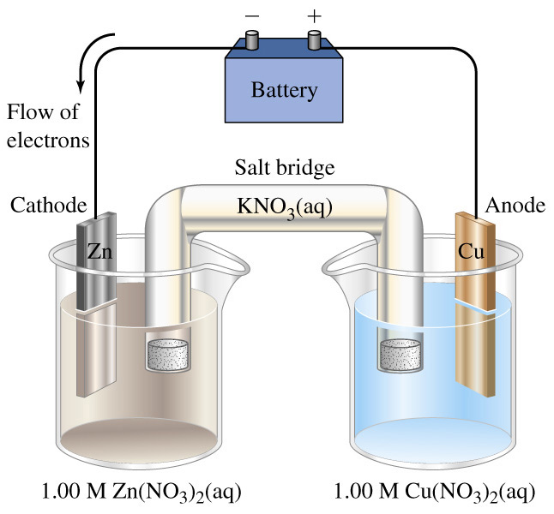

Slide 18
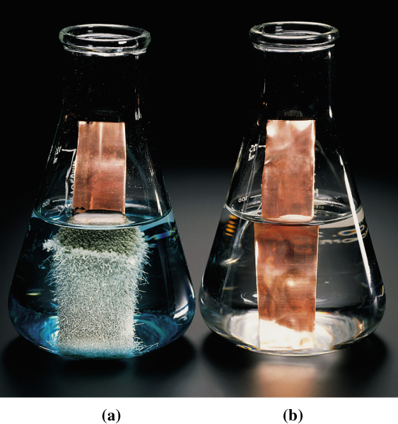

Slide 19
http://www.physchem.co.za/Redox/Electrolysis.htm
More good stuff

